Slide 1



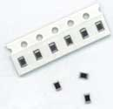

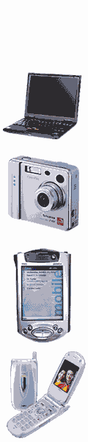

The World Class Multilayer Ceramic Varistor
Introduction
SFI company
is the professor manufacturer who has successfully
developed the mono chip and the multi-layer chip TVS
(transient voltage suppressors) as well as set mass
production in Taiwan.
Our products also feature low clamping voltage,
low working voltage and low leakage current. This also holds effect for system against ESD and noise.
We develop the low capacity for high speed (USB 2.0)
port .
For more information, contact us today.
SFI 公司
是臺灣專業生產被動保護元件，利用單晶片及多層膜的技術開發出全系列尺寸的暫態電壓抑制器，能有效的將靜電及突波加以抑制，具有超低工作電壓及箝制電壓，目前更開發出低電容系列能完成符合傳輸線在高速時(USB2.0)使用。
如需更多資訊請與我們業務部門聯絡
等效線路Equivalent Circuit
應用 Application
☆L Body Inductance
☆C Device Capacitance
☆Rv Voltage Variable Resistor
☆R Insulation Resistor
L
■筆記型電腦 Notebook
■數位相機 Digital Camera
■個人隨身秘書 PDA
■行動電話 Cellular Phone
■數位隨身聽 MP3
■主機版 Motherboard
■液晶模組 LCM
■路由器 HUB
■麥克風耳機 Microphone
■無線區域網路 Wireless LAN
■網路電話 VOIP
R
Rv
C
聯絡我們 Contact us
功能 Function
■電話 : 03-3216666
■傳真 : 03-3584544
■E-mail : composfi@ms52.hinet.net
■地址 : 桃園縣龜山鄉山鶯路340巷6號
★TEL :03-3216666
★FAX :03-3584544
★E-mail : composfi@ms52.hinet.net
★Address : NO.6, LANE340, SHAN YING RD, GUI SHAN HSIEN, TAO YUAN TAIWAN R.O.C.
■反應速度 Fast Response < 0.5nS
■工作電壓 Low Working Voltage 3.3V
■低電容值 Low Capacitance 2.5PF
■低漏電流 Low Leakage Current < 0.1 uA
■箝制電壓 Low Clamping Voltage
■沒有極性 Bi-direction

Slide 2
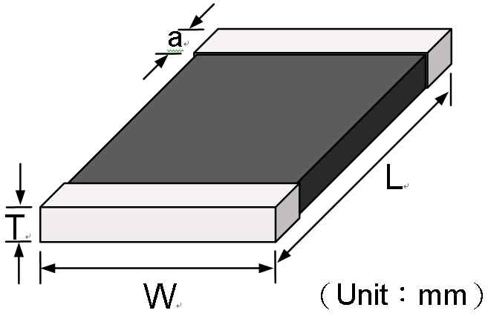

規格Specification for 0402 size and 0603 size
Part No, | Working Voltage | Clamping Voltage | Leakage Current | Capacitance Volume | Insulation Resistance
(Unit) | VDC (max) | Vclamp(max) | uA(max) | PF | Ohm(Min)
SFIXXXX-050E101MP | 5 | 18 | 0.1 | 100 | 50
SFIXXXX-050E820MP | 5 | 18 | 0.1 | 82 | 50
SFIXXXX-050E560MP | 5 | 18 | 0.1 | 56 | 50
SFIXXXX-050E330MP | 5 | 18 | 0.1 | 33 | 50
SFIXXXX-050E220MP | 5 | 18 | 0.1 | 22 | 50
SFIXXXX-050E100MP | 5 | 18 | 0.1 | 10 | 50
SFIXXXX-050E050MP | 5 | 18 | 0.1 | 5~9 | 50
SFIXXXX-120E101MP | 12 | 22 | 0.1 | 100 | 120
SFIXXXX-120E820MP | 12 | 22 | 0.1 | 82 | 120
SFIXXXX-120E560MP | 12 | 22 | 0.1 | 56 | 120
SFIXXXX-120E330MP | 12 | 22 | 0.1 | 33 | 120
SFIXXXX-120E220MP | 12 | 22 | 0.1 | 22 | 120
SFIXXXX-120E100MP | 12 | 22 | 0.1 | 10 | 120
SFIXXXX-120E050MP | 12 | 22 | 0.1 | 4 ~9 | 120
SFI0XXXX-240E2R5MP | 24 | 80 | 0.1 | 2~4 | 120
1 The MAX Working Voltage is suited for under 24 V include 3.3V、5V、8V、12V。
2.This Clamping Voltage at which the device stabilized during the transition from high to low impedance IEC61000-4-2. 30A@8KV,level4,clamp
measurement made 30ns after initiation of pulse, all test in contact discharge mode。
3. All capacitance test under 1K Hz Tolerance at +-20%(M) exception under 5PF for +80% -20%。
4. The Leakage current was measured at working voltage
5. The Insulation Resistor was measured at working voltage
Note: Details are subject to change without prior notice. Please inquire to our sale office for details.
尺寸 Size
Model | 0402(1005) Series | 0603(1608) Series
Length(L) | 1.0 ±0.15 | 1.60 ±0.15
Width(W) | 0.50 ±0.15 | 0.80 ±0.15
Thickness(T) | 0.6 Max | 0.9 Max
Termination(a) | 0.25 ±0.1 | 0.3 ±0.1
各個系統傳輸時所建議的電容值 Recommend Item for System Used
Device Description (應用界面) | Data Rate &Frequency (傳輸速度) | Rise time (上升時間) | Capacitance (建議使用電容值)
USB 2.0 Data Port | 480 M bps | 0.5~0.6 nS | < 4PF
USB1.1 Data Port | 12 M bps | 4~20 nS | 5~10PF
Wireless device | 1.5 M bps | 75~300 nS | 5~10PF
RS232、IrDA1.0 | 115.2 K | 1uS~8 uS | 10~100PF
Audio (Microphone/Speaker) | 20~20K Hz | 0.05mS~50 mS | 10~100PF

Slide 3


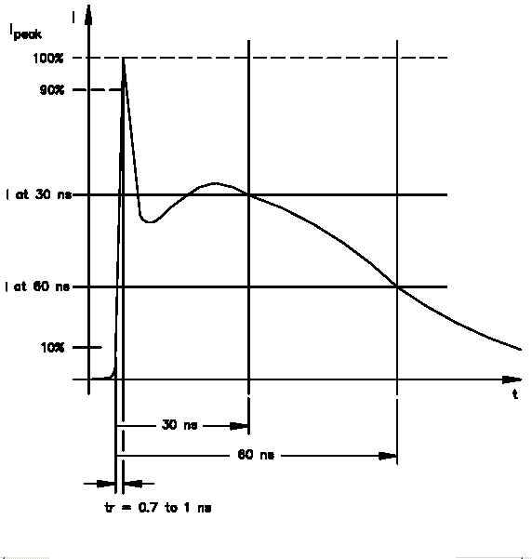
靜電描述 ESD Description
靜電
一般而言,對於靜電的防制選擇的元件並不是很容易,所以必須了解一些靜電的特性是很重要的.
靜電是一種瞬間突波,具有非常快的上升時間,高壓有時可達數拾仟伏,雖然靜電能量不大, 但在此能量對於某些耐靜電能力比較差的積體電路也會造成破壞.
由於靜電能量不大,所以在選擇保護元漸上的耐電流能量的能力就不是那麼需求,所以說選擇的保護元件規格的重要特性就在於:
1.平常時並不能有漏電流過大的情形.
2.在高速傳輸時低電容所造成的容抗須被注意.
3.符合IEC61000-4-2 規定
Electrostatic discharge (ESD) problems become more common in electronic circuits, devices based on various technologies have also become readily available to protect circuits from ESD. However, it is not always easy to select the appropriate protection device for a circuit, because there are almost too many choices available. It is important to understand the nature of each protection device and to evaluate its characteristics against the requirements of the circuit to be protected.
ESD in this context is a high-voltage transient with fast rise time . Several thousand volts of ESD with a high rise time (dv/dt) could break through the junction layer of protective devices easily and cause damage.
ESD surge energy, however, is very small, and it does not require much energy-handling capability from a protective device. Therefore the best impartment factor for ESD component is
1.leakage current for normal situation,
2.the low capacity for high speed impedance
3.Pass IEC61000-4-2 rule
靜電國際標準規範 IEC61000-4 Standard
靜電波形ESD Wave form
SEVERITY LEVEL(等級) | AIR DIRCHARGE (空氣) | DIRECT DISCHARGE (接 觸)
1 | 2 KV | 2 KV
2 | 4 KV | 4 KV
3 | 8 KV | 6 KV
4 | 15 KV | 8 KV
X | Special | Special
Notes:
1. "X" is an open level.
2. The test severity levels shall be selected in accordance with the most realistic installation and environmental conditions.
採用靜電放電保護元件的考量條件 The Importment Factor for choose the ESD Component
■Response time ：Generation say under 1 nS
■Working Voltage： More higher than system normal voltage
■Capacitance： It depend the system transfer speed
■Leakage Current： As low as good
■Clamping Voltage：According to the System Design
■Direction：Bi-Direction is better
■Withstanding：As more pulses as good
■反應時間越快越好,小於1nS
■工作電壓略高於系統設計
■低電容值依系統傳輸設計基本上越小越好
■低漏電流依系統傳輸設計基本上越小越好
■箝制電壓依系統設計
■沒有極性
■耐靜電能力越多次越好

Slide 4
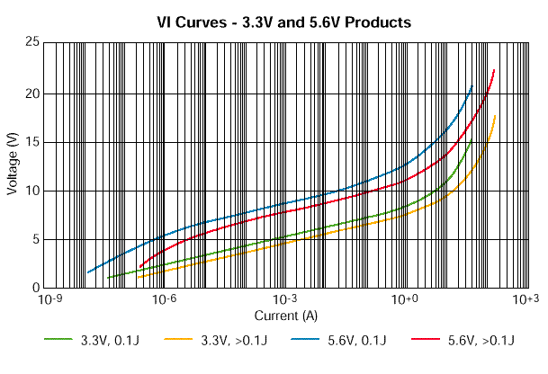
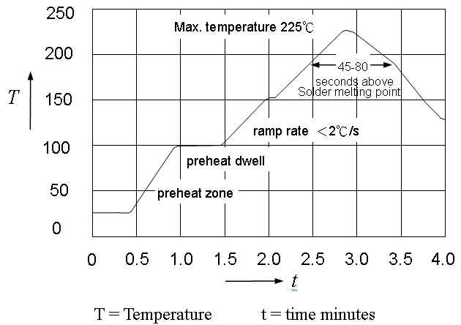
內電極
Inner electrode
半導性材質
材質 Materials
Semiconducting Ceramic
■本體材質 Base material: 氧化鋅ZnO
■端極材質 Terminal: 銀 Ag / 钯 Pa
End Termination
端極
動作原理 Activity Principal
V-I Curve
■When the voltage increases above the threshold of the TVS, the suppressor draws a rapidly increasing current . Then the overvoltage is considerably attenuated.
■當電壓值上升一超過崩潰門檻，即會誘引電流流通量急速增加，負載就會順勢大量衰減
Size
錫臚溫度特性Infra Red (IR) Reflow
IR soldering has the highest yields due to controlled heating rates and solder liquidus times. Make sure that the element is not subjected to a thermal gradient steeper than 4 degrees per second. 2 degrees per second is the ideal gradient. During the soldering process, pre- heating to within 100 degrees of the solders peak temper-
ature is essential to minimize thermal shock.
因為迴焊爐有昇溫控制及錫液態時間會有最高產出，確保零件溫度加溫時不能超過4℃/sec，理想速度是2℃/sec，於熔焊過程中為了避免熱衝擊預熱必須界於最高溫內100℃。
如何訂購 How to Order
SFI
0402
050
E
220
M
P
Company Logo
Size
0402
0603
Working
Voltage
5V
12V
24V
ESD
Series
Capacitance
Value
Capacitance
Tolerance
+-20%
+80%-20%
Package

